Slide 1
Abstraction & Polymorphism

Slide 2

Objectives
At the end of this session, you will be able to
Understand the concept of Abstract Classes & Interfaces
Use the final keyword
Implement Static and Dynamic Polymorphism
Understand different Access Modifiers
Understand and use Packages.

Slide 3
Agenda
Abstract Classes
final keyword
Interfaces
Static and Dynamic Polymorphism
Access Modifiers
Packages.

Slide 4



Abstract Class
A class is made abstract when it is so general that it should not be instantiated.
new Car()
new Bike()
new Vehicle()

Slide 5
Abstract Class
An abstract class is used to carry out a planned hierarchy.
An abstract class has no direct instances, but whose descendants may have instances.
Vehicle
Cannot be
Instantiated
Can be
Instantiated
Bike
Car

Slide 6
Abstract Class
Java uses the modifier abstract to declare an abstract class as well as an abstract method.
Abstract methods do not have a body
abstract class Vehicle{
…
public abstract void start(); //does not have a body
…
}
An abstract class is a type. So though an object of an abstract class cannot be created, it is perfectly fine to use a variable of an abstract class type
Vehicle v ; // OK
v = new Vehicle();
Abstract classes can not be instantiated

Slide 7
Abstract Class
When an abstract class is inherited, the subclass MUST implement all abstract methods in its parent class
If it does not, the subclass must also be declared abstract
abstract class Vehicle{ //abstract class
public abstract void start(); //abstract method
}
class Car extends Vehicle{ //extending an abstract class
public void start(){ //overriding an abstract method //code to start car
}
}
Concrete class

Slide 8
Final Classes
A final class cannot be sub classed.
Many of the classes in Java standard library are final
Example: java.lang.System and java.lang.String.
All methods in a final class are implicitly final.
public final class MyFinalClass {
………………
}
public class NewClass extends MyFinalClass{
}

Slide 9
Final Methods
A final method cannot be overridden by subclasses.
public class Student {
public final void registerForExam() {
... }
}
public class ArtsStudent extends Student{
public void registerForExam() {
... }
}
Student
Science Student
Arts Student
Commerce Student

Slide 10
Final Variable
A final variable is a constant.
It can only be assigned a value once.
public class MyClass {
public static final double PI=3.1415926535879;
void changePI(){
PI=3.14;
}
}

Slide 11
Interface
Java interfaces are the specifications for one or all the functionalities exhibited by an object.
It is a 100% abstract class in which none of the methods have body.
The Java interface is a development contract to ensure that a particular object satisfies a given set of specifications.
In Java, an interface is a reference type, similar to a class
Cannot be instantiated — they can only be implemented by classes or extended by other interfaces
An interface can extend another interface
A class can extend one class but implement multiple interfaces

Slide 12
Need for Interfaces
To reveal an object's programming interface (functionality of the object) without revealing its implementation
To have unrelated classes implement similar methods (behaviors)
To model multiple inheritance
Notes:
1. This is the concept of encapsulation
– The implementation can change without affecting the caller of the interface
– The caller does not need the implementation at the compile time
● It needs only the interface at the compile time
● During runtime, actual object instance is associated with the interface type
2. Example:
– Class Line and class MyInteger
● They are not related through inheritance
● You want both to implement comparison methods
– checkIsGreater(Object x, Object y)
– checkIsLess(Object x, Object y)
– checkIsEqual(Object x, Object y)
– Define Comparison interface which has the three abstract methods above
3. A class can implement multiple interfaces while it can extend only one class

Slide 13

Interface
Vehicle
Remember
An interface requires
all its methods to be
overridden
One cannot create
an object of an
interface
color
maxSpeed
brand
start()
stop()
accelerate()
changeGear()
Developer
forgets to
override the
start() method, and
the car never takes
off….
Car
color
maxSpeed
brand
stop()
accelerate()
changeGear()

Slide 14
Interface
Interfaces are declared with the interface keyword.
Variables & methods declared in interfaces are public by default
Interfaces can only contain method signatures (abstract, by default) and constant declarations (static and final, by default).
//Interface named Vehicle
interface Vehicle{
public static final int MAXSPEED = 200;
//start method without any body
public abstract void start();
}

Slide 15
Interface
A class can implement one or more interfaces by using implements keyword.
All methods in the interface must be implemented (overridden) in this class. Else, the class should be declared abstract.
// Car class implementing Vehicle interface
class Car implements Vehicle{
//overridden start() method
public void start(){…};
//other useful functionalities (methods)
}
Interface methods must not be static and also cannot be marked as final

Slide 16
Interface
interface Vehicle{
public abstract void start(); //Here
public abstract void stop(); //none of the
public abstract void accelerate(); // methods
public abstract void changeGear(); //have body
}
class Car implements Vehicle {
public void start(){…}; //Here all
public void stop(){…}; //abstract
public void accelerate(){…}; //methods are
public void changeGear(){…}; //overridden
}

Slide 17

Polymorphism
Polymorphism: One name, many forms
Polymorphism manifests itself in Java in the form of multiple methods having the same name.
It is of two types.
POLYMORPHISM
Static / Compile-Time
Polymorphism
Dynamic / Run-Time
Polymorphism

Slide 18
Static Polymorphism
Compile Time Polymorphism
The decision about which method to execute is made at compile time
Method calls are bound to their implementation immediately and hence known as static binding
Can be achieved by using Method Overloading.
Overloaded methods:
Can appear in the same or sub classes
have the same name
have different parameter lists
can have different return types
can be implemented in subclasses.

Slide 19
Method Overloading
Your design may call for several methods in the same class with the same name but with different arguments.
public void print (int i)
public void print (float f)
public void print (int a, int b)
Java permits you to reuse a method name for more than one method.
Two rules apply to overloaded methods:
Argument lists must differ.
Return types can be different.
Therefore, the following is not legal:
public void print (int i)
public String print (int i)

Slide 20



Static Polymorphism
SoccerPlayer
GoalKeeper
goalKick
frontTackleKick

Slide 21
Static Polymorphism
SoccerPlayer
Few common behavior
run()
kick()
possession()
interception()
……
Types Of Kick
freeKick()
bananaKick()
bicycleKick()
frontTackle()
goalKick()
cornerKick()
dropKick()
kick(freeKick)
kick(bananaKick)
kick(bicycleKick)
kick(frontTackle)
kick(goalKick)
kick(cornerKick)
kick(dropKick)
BAD OO

Slide 22
Dynamic Polymorphism
Dynamic Polymorphism
The decision about which method to execute is made at the run time.
This can be achieved by using method overriding.
Method Overriding:
Multiple methods having same name and same signature in different classes in a class hierarchy.
Can be implemented in two ways:
Overriding through inheritance
Overriding through interface

Slide 23
Dynamic Polymorphism
Method overriding through Inheritance
A subclass can override a method defined in its superclass by providing a new implementation for that method
The new method definition must have the same method signature (i.e., method name & parameters) and return type
The new method definition cannot narrow down the accessibility of the method, but it can widen it

Slide 24

Dynamic Polymorphism
SoccerPlayer
run()
kick()
possession()
interception()
……
GoalKeeper
Striker
The possession() method for GoalKeeper would be different, because he can use
his hands too.
Hence, the child class GoalKeeper would override the possession() method of
parent class SoccerPlayer.

Slide 25
Dynamic Polymorphism
Through Inheritance
SoccerPlayer
run()
kick(freeKick)
kick(cornerKick)
…
possession()
interception()
Overloaded method
Goalkeeper
Striker
Defender
kick(dropKick)
possession()
defend()
kick(goalKick)
kick(frontTackle)
Overridden method
Newly added method

Slide 26
Dynamic Polymorphism
Through Interface
An interface reference variable can be used to refer to any object of any class that implements that interface.
This works the same with super classes.
However, the interface reference can access only the overridden methods of the implementing class.
SoccerPlayer sp = new GoalKeeper();
sp.possession(); //Run-Time Polymorphism
sp.defend(); //ERROR

Slide 27
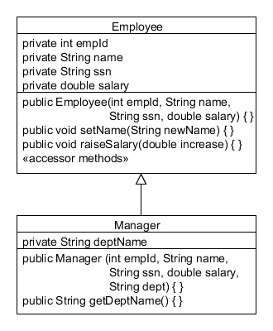
Polymorphism in JAVA
In an object-oriented language like Java, subclassing is used to define a new class in terms of an existing one.
superclass: Employee ("parent" class)
this means "inherits"
subclass: Manager, is an Employee
("child" class)

Slide 28
Constructing a Manager Object
Creating a Manager object is the same as creating an Employee object:
Manager mgr = new Manager (102, "Barbara Jones", "107-99-9078", 109345.67, "Marketing");
All of the Employee methods are available to Manager:
mgr.raiseSalary (10000.00);
The Manager class defines a new method to get the Department Name:
String dept = mgr.getDeptName();

Slide 29
Polymorphism in JAVA
The word polymorphism, strictly defined, means “many forms.”
Employee emp = new Manager();
This assignment is perfectly legal. An employee can be a manager.
However, the following does not compile:
emp.setDeptName ("Marketing"); // compiler error!
The Java compiler recognizes the emp variable only as an Employee object. Because the Employee class does not have a setDeptName method, it shows an error.

Slide 30
Interfaces Vs Subclasses
Make a subclass only when you want to make a more specific version of a class.
Use an interface when you want to define a role that other classes can play

Slide 31
Introduction to Packages
Why Packages?
To avoid naming conflicts
To control access
To achieve Reusability
What is a Package?
Package is a container used to group related classes, interfaces & sub-packages providing access and namespace management

Slide 32
Packages
(.) notation is used to identify package members in the package hierarchy.
eg:
package mypackage.mysubpackage //subpackage declaration
public class MyClass{ //class in subpackage
…..
}
mypackage
mysubpackage
MyClass

Slide 33
Packages
Strict file & directory naming conventions to be followed
All classes put into a package must reside in a directory with that package name
Package name is specified at the beginning of the java code

Slide 34
Predefined Packages
Already defined in the Java API library & can be imported into user programs
Examples of predefined packages:
java.lang.*; Frequently required Operations (By default, it is imported)
java.util.*; Utility Operations
java.sql.*; Database operations
java.net.*; Networking operations
java.io.*; File related operations
A package can be imported as below
import java.sql.*;
import java.sql.Connection; //BEST PRACTICE
Notes:
String & StringBuffer class which are already used using Java API Documentation are belong to java.lang package

Slide 35
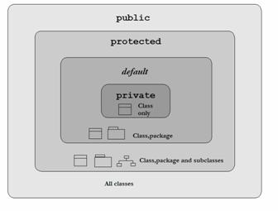
Access Modifiers
Access modifiers control what information is accessible to other classes.
In the order of increasing access level:
private (accessible within the class)
default (accessible within the package)
protected (accessible within the package + subclass in other package)
public (accessible to all)

Slide 36
Public Modifier
A member (variable or method) with this access modifier can be accessed by any class
- within the class
- another class in the same package,
- another class in the another package,
- sub class in another package.
I am public and I have a public method aMethod()
Package1
Package2
ClassA
ClassC
Class
Achild
Class
AChild
ClassB

Slide 37
Private Modifier
A member with private access modifier can be accessed from the same class
but cannot be accessed by:
- another class in the same package,
- sub class in same package,
- another class in the another package,
- sub class in another package
I have a private method aMethod()
Package1
Package2
ClassA
Class
Achild
Class
Achild
ClassB
ClassB

Slide 38
Protected Modifier
A member with protected access modifier can be accessed from
- the same class
- another class in the same package,
- sub class in the same package,
- sub class in the another package
But cannot be accessed by:
- another class in another package,
I have a protected method aMethod()
Package1
Package2
ClassA
Class
Achild
Class
Achild
ClassB
ClassB

Slide 39
Default Modifier
A member with default access modifier can be accessed from
- the same class
- another class in the same package,
- sub class in the same package
But cannot be accessed by:
- sub class in the another package
- another class in another package,
I have a default method aMethod()
Package1
Package2
ClassA
Class
Achild
Class
Achild
ClassB
ClassB

Slide 40
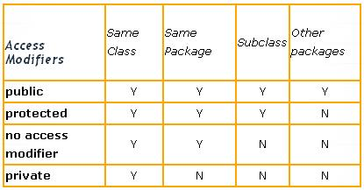
Access Modifier Summary

Slide 41
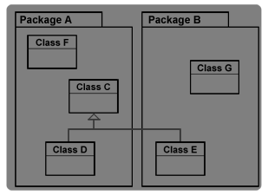
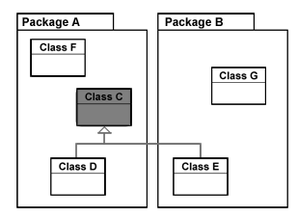
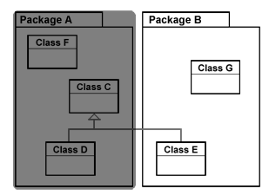
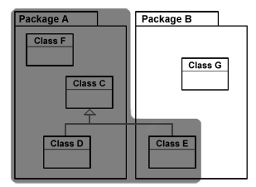
Activity :
Identifiy the access modifier
?
?
?
?

Slide 42
Nested Classes
A nested class is a class declared within the body of another class. Nested classes:
Have multiple categories
Inner classes
Member classes
Local classes
Anonymous classes
Static nested classes
Are commonly used in applications with GUI elements
Can limit utilization of a "helper class" to the enclosing top-level class

Slide 43
Inner Classes
An Inner Class:
is declared inside the curly braces of another class
is outside any method or other code block.
can be marked with any access modifier as well as the abstract or final modifiers
instance shares a special relationship with an instance of the enclosing class.
Can access all of the outer class’ members, including those marked private.
Cannot have any static members.

Slide 44
Inner Class: Example
public class Car {
private boolean running = false;
private Engine engine = new Engine();
private class Engine {
public void start() {
running = true;
}
}
public void start() {
engine.start();
}
}

Slide 45
Try it out
Q1. An abstract class can have both abstract methods and non-abstract methods. (TRUE/FALSE).
Q2. Is the below method overloaded?
void add(int a, float b)
int add(int a, float b)
Q3. An interface can ________ another interface
Q4. A class can _________ one or more interfaces
Q5. Fill the blanks
public interface Foo{
_________ _________ _________ int x=1;
_________ _________ void bar();
}

Slide 46
Try it out
Q6. Access modifiers cannot be applied to ________
a) class b) instance variables c) instance methods d) local variables
Q7. A java source file can have ______(one/multiple) package statement and _______(one/multiple) import statement.
Q8. The import statement (if any) must come ________ (before/after) the package statement and __________ (before/after) the class declaration.
Q9. Why the below code fails to compile?
class Animal{
public void eat(){
System.out.println(“Animal eating”);
}}
class Horse extends Animal{
void eat(){
System.out.println(“Horse eating”);
}}

Slide 47
Summary
In this session, we have covered:
Abstract Classes
final keyword
Interfaces
Static and Dynamic Polymorphism
Access Modifiers
Packages

Slide 48
Thank you

